Slide 1
Software System Modeling

Slide 2

Agenda
Structural design patterns

Slide 3
Resources
Head First Design Patterns
https://refactoring.guru/design-patterns
https://mermaid-js.github.io/ - class diagrams

Slide 4
Structural Design patterns

Slide 5
Quiz

Slide 6
Structural design patterns explain how to assemble objects and classes into larger structures, while keeping these structures flexible and efficient.

Slide 7
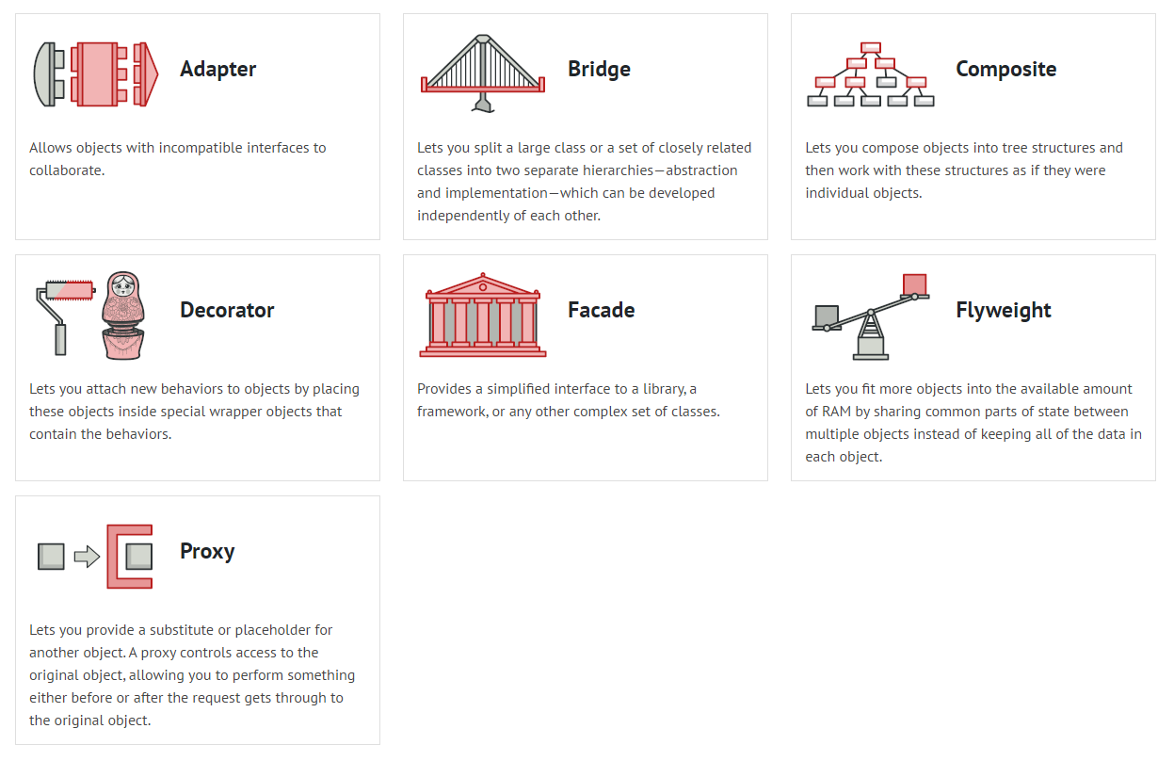

Slide 8
Adapter
Adapter is a structural design pattern that allows objects with incompatible interfaces to collaborate.

Slide 9
Problem
Imagine that you’re creating a stock market monitoring app. The app downloads the stock data from multiple sources in XML format
At some point, you decide to improve the app by integrating a smart 3rd-party analytics library. But there’s a catch: the analytics library only works with data in JSON format.

Slide 10
Solution
Adapters can not only convert data into various formats but can also help objects with different interfaces collaborate. Here’s how it works:
The adapter gets an interface, compatible with one of the existing objects.
Using this interface, the existing object can safely call the adapter’s methods.
Upon receiving a call, the adapter passes the request to the second object, but in a format and order that the second object expects.

Slide 11
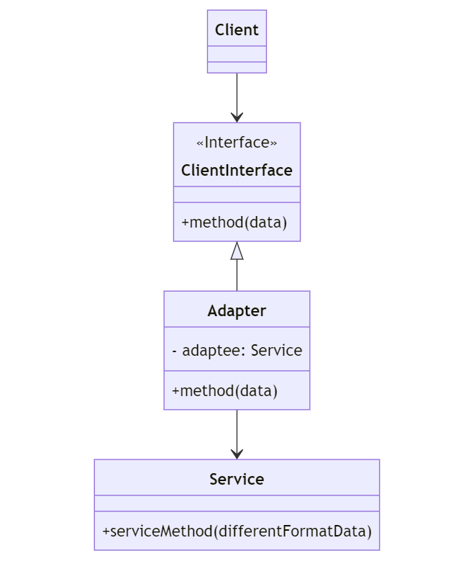

Slide 12
Pros
Cons
Single Responsibility Principle. You can separate the interface or data conversion code from the primary business logic of the program.
Open/Closed Principle. You can introduce new types of adapters into the program without breaking the existing client code, as long as they work with the adapters through the client interface.
The overall complexity of the code increases because you need to introduce a set of new interfaces and classes. Sometimes it’s simpler just to change the service class so that it matches the rest of your code.

Slide 13
Bridge
Bridge is a structural design pattern that lets you split a large class or a set of closely related classes into two separate hierarchies—abstraction and implementation—which can be developed independently of each other.

Slide 14
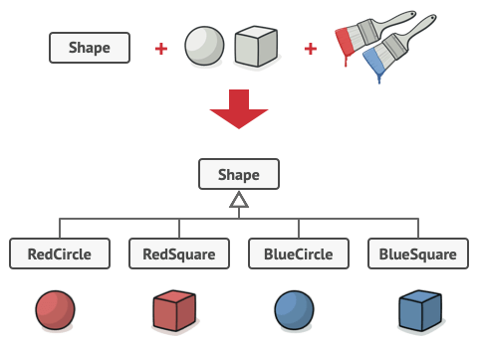
Problem
Say you have a geometric Shape class with a pair of subclasses: Circle and Square. You want to extend this class hierarchy to incorporate colors, so you plan to create Red and Blue shape subclasses. However, since you already have two subclasses, you’ll need to create four class combinations such as BlueCircle and RedSquare.

Slide 15
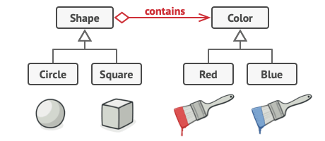
Solution
The Bridge pattern attempts to solve this problem by switching from inheritance to the object composition. What this means is that you extract one of the dimensions into a separate class hierarchy, so that the original classes will reference an object of the new hierarchy, instead of having all of its state and behaviors within one class.

Slide 16
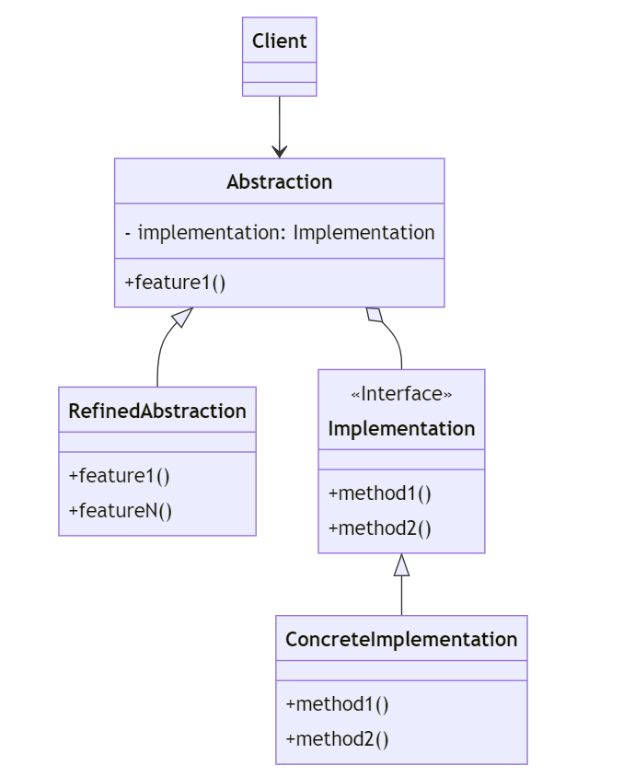

Slide 17
Pros
Cons
You can create platform-independent classes and apps.
The client code works with high-level abstractions. It isn’t exposed to the platform details.
Open/Closed Principle. You can introduce new abstractions and implementations independently from each other.
Single Responsibility Principle. You can focus on high-level logic in the abstraction and on platform details in the implementation.
You might make the code more complicated by applying the pattern to a highly cohesive class.

Slide 18
Composite
Composite is a structural design pattern that lets you compose objects into tree structures and then work with these structures as if they were individual objects.

Slide 19
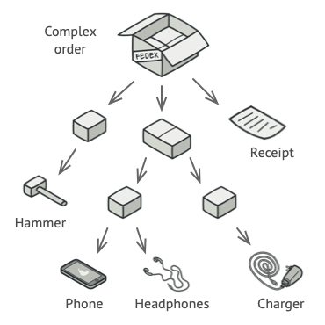
Problem
For example, imagine that you have two types of objects: Products and Boxes. A Box can contain several Products as well as a few smaller Boxes. These little Boxes can also hold some Products or even smaller Boxes, and so on.
Say you decide to create an ordering system that uses these classes. Orders could contain simple products without any wrapping, as well as boxes stuffed with products...and other boxes. How would you determine the total price of such an order?

Slide 20
Solution
Composite pattern suggests that you work with Products and Boxes through a common interface which declares a method for calculating the total price.
How would this method work? For a product, it’d simply return the product’s price. For a box, it’d go over each item the box contains, ask its price and then return a total for this box.

Slide 21
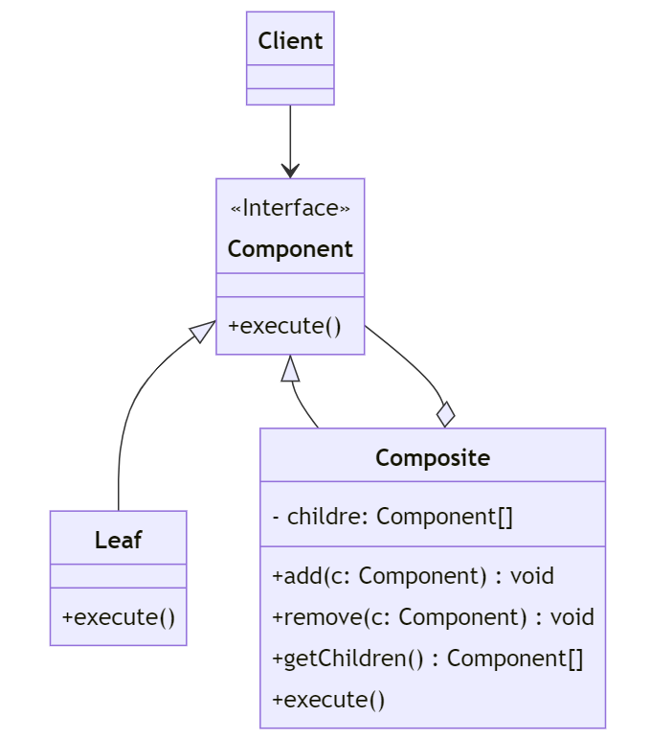

Slide 22
Pros
Cons
You can work with complex tree structures more conveniently: use polymorphism and recursion to your advantage.
Open/Closed Principle. You can introduce new element types into the app without breaking the existing code, which now works with the object tree.
It might be difficult to provide a common interface for classes whose functionality differs too much. In certain scenarios, you’d need to overgeneralize the component interface, making it harder to comprehend.

Slide 23
Decorator
Decorator is a structural design pattern that lets you attach new behaviors to objects by placing these objects inside special wrapper objects that contain the behaviors.

Slide 24
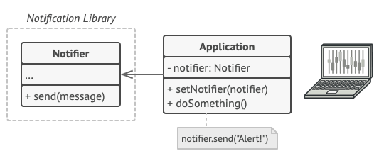
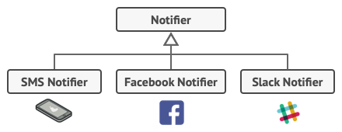
Problem
Imagine that you’re working on a notification library which lets other programs notify their users about important events.
The initial version of the library would accept a message argument from a client and send the message to a list of emails
But soon many of them would like to receive an SMS about critical issues or to be notified on Facebook or Slack notifications.

Slide 25
Solution
“Wrapper” is the alternative nickname for the Decorator pattern that clearly expresses the main idea of the pattern. A wrapper is an object that can be linked with some target object. The wrapper contains the same set of methods as the target and delegates to it all requests it receives. However, the wrapper may alter the result by doing something either before or after it passes the request to the target.
Decorator
Decorator
Object to be decorated

Slide 26
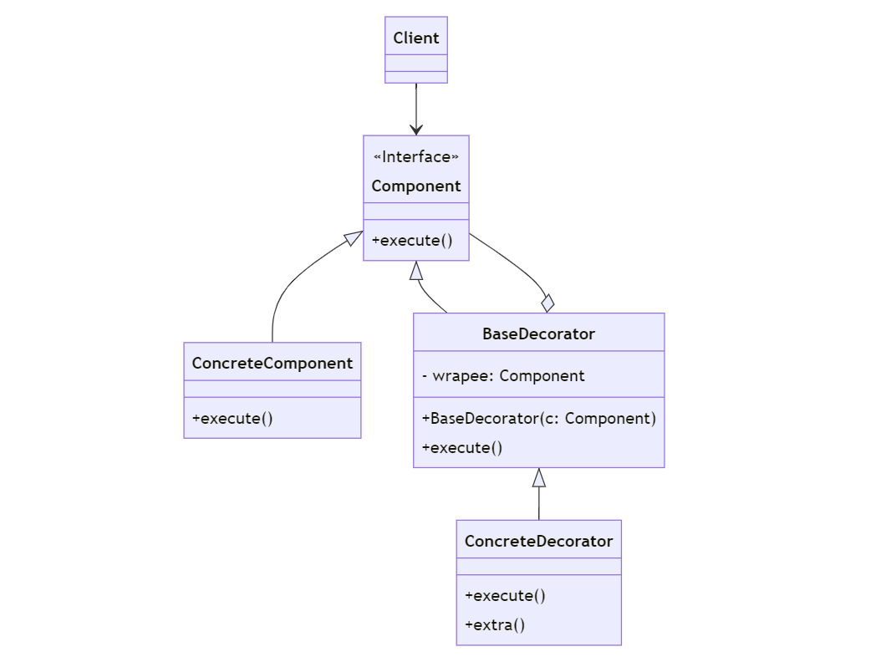

Slide 27
Pros
Cons
You can extend an object’s behavior without making a new subclass.
You can add or remove responsibilities from an object at runtime.
You can combine several behaviors by wrapping an object into multiple decorators.
Single Responsibility Principle. You can divide a monolithic class that implements many possible variants of behavior into several smaller classes.
It’s hard to remove a specific wrapper from the wrappers stack.
It’s hard to implement a decorator in such a way that its behavior doesn’t depend on the order in the decorators stack.
The initial configuration code of layers might look pretty ugly.

Slide 28
FlyWeight
Flyweight is a structural design pattern that lets you fit more objects into the available amount of RAM by sharing common parts of state between multiple objects instead of keeping all of the data in each object.

Slide 29
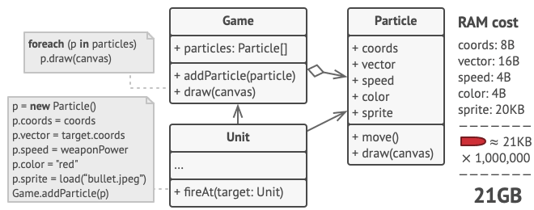
Problem
Imagine that you’re working on a video game – first-person shooter.
Each particle, such as a bullet, a missile or a piece of shrapnel is represented by a separate object containing plenty of data. If it is very expensive to create this objects, at some point newly created particles can no longer fit into the remaining RAM, making the program to crash.

Slide 30
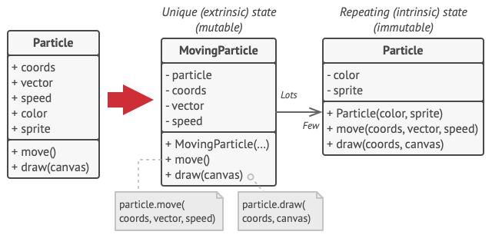
Solution
The Flyweight pattern suggests that you stop storing the extrinsic state inside the object. Instead, you should pass this state to specific methods which rely on it. Only the intrinsic state stays within the object, letting you reuse it in different contexts. As a result, you’d need fewer of these objects since they only differ in the intrinsic state, which has much fewer variations than the extrinsic.

Slide 31
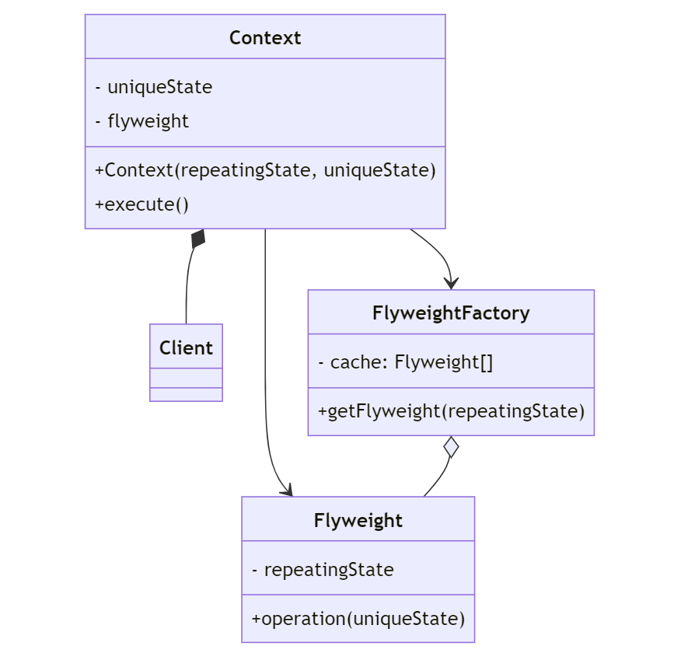

Slide 32
Pros
Cons
You can save lots of RAM, assuming your program has tons of similar objects.
You might be trading RAM over CPU cycles when some of the context data needs to be recalculated each time somebody calls a flyweight method.
The code becomes much more complicated. New team members will always be wondering why the state of an entity was separated in such a way.

Slide 33
Proxy
Proxy is a structural design pattern that lets you provide a substitute or placeholder for another object. A proxy controls access to the original object, allowing you to perform something either before or after the request gets through to the original object.

Slide 34
Problem
Why would you want to control access to an object? Here is an example: you have a massive object that consumes a vast amount of system resources. You need it from time to time, but not always.
You could implement lazy initialization: create this object only when it’s needed. All the object’s clients would need to execute some deferred initialization code. Unfortunately, this would probably cause a lot of code duplication.
In an ideal world, we’d want to put this code directly into our object’s class, but that isn’t always possible.

Slide 35

Solution
The Proxy pattern suggests that you create a new proxy class with the same interface as an original service object. Then you update your app so that it passes the proxy object to all the original object’s clients. Upon receiving a request from a client, the proxy creates a real service object and delegates all the work to it.
Client
Database
Client
Client
Proxy

Slide 36
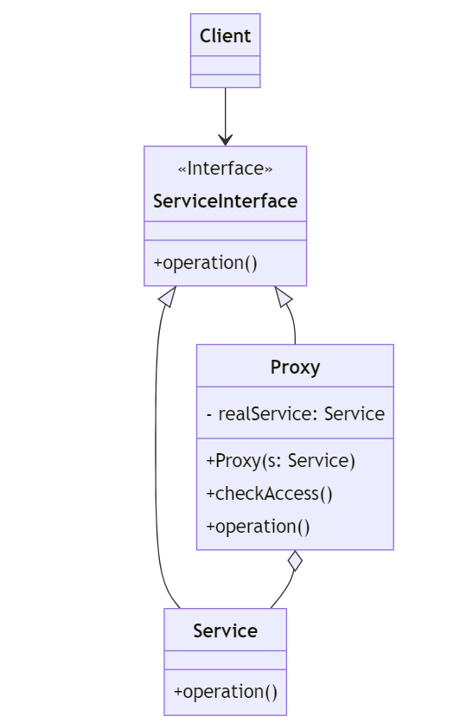

Slide 37
Pros
Cons
You can save lots of RAM, assuming your program has tons of similar objects.
You might be trading RAM over CPU cycles when some of the context data needs to be recalculated each time somebody calls a flyweight method.
The code becomes much more complicated. New team members will always be wondering why the state of an entity was separated in such a way.

